Slide 1



DIABETES Analysis Using IBM SPSS Modeler
Presented by : Priyanshu Anand

Slide 2


Introduction
Diabetes Mellitus is characterized by elevated sugar levels in the human body resulting from the body’s inability to produce insulin adequately. It can lead to major health problems like cardiovascular disease, kidney failure, and nerve damage.
Predictive analytics helps identify individuals at high risk of diabetes using relevant data such as glucose level, blood pressure, BMI, insulin level, and age.This project applies data mining and machine learning techniques to classify individuals as diabetic or non-diabetic using IBM SPSS Modeler.

Slide 3
Project Objectives: Prediction and Analysis
->Predict whether an individual is diabetic using
key medical parameters.
->Identify the most influential factors contributing
to diabetes risk.
->Develop and compare multiple machine learning
models in IBM SPSS Modeler.
->Determine the most accurate model to support early
medical intervention.

Slide 4

Data Preparation and Partitioning
Data preparation involved importing the dataset using the Var. File node, followed by a comprehensive Data Audit to identify missing or inconsistent values. All zero entries were treated as missing and imputed using median values to maintain data integrity. The dataset was then partitioned into 70% training and 30% testing subsets, and the outcome variable was designated as the Target (Nominal) to support supervised model.

Slide 5

Predictive Models: C5.0 Decision Tree & Logistic Regression
Three predictive models were developed to evaluate classification performance: the C5.0 Decision Tree, which provides transparent decision rules and highlights key variables; Logistic Regression, which estimates probability scores based on statistically derived predictor coefficients; and the Random Forest, an ensemble-based model that aggregates multiple decision trees to enhance accuracy and reduce variance. All models were trained using the same set of input features to ensure a fair and consistent performance comparison.

Slide 6
Model Evaluation and Comparison with Insights
Logistic Regression – ~76% Accuracy Serves as a strong baseline model with consistent performance.
C5.0 Decision Tree – ~80% Accuracy Offers good interpretability while improving accuracy over the baseline.
Random Forest – ~85% Accuracy Provides the highest accuracy and strongest overall predictive performance.

Slide 7
Conclusions
This project successfully implemented a diabetes prediction system using IBM SPSS Modeler.After evaluating multiple machine learning models, the Random Forest model demonstrated the best accuracy of ~85%. This model can assist doctors and medical practitioners by identifying high-risk individuals at an early stage.

Slide 8
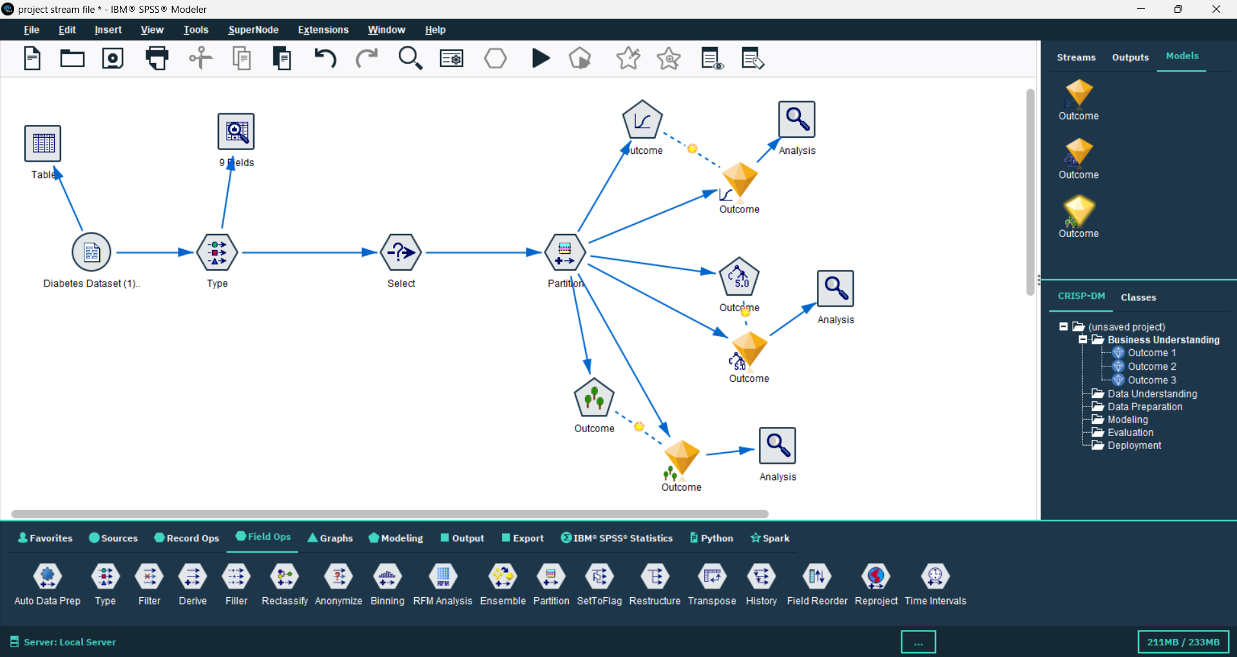
Final Stream

Slide 9

Thank you !
Please keep this slide for attribution

